Slide 1

ICT Application and Achievements in Livestock Industry
Byung Chul Lee

Slide 2
ICT Application in Livestock Farm
Environment Control : Inside Shed(Temperature, Humidity, Power Outage, Fire, Bad Smell, CO2 Control, etc.), Outside Shed (Wind Direction, Wind Speed), CCTV
Breeding Management : Automatic Feeder, Reproduction Management System, Weight Scale, etc.
Other : Feed Bin Management Device, Sorting & Shipping System, Water Intake Management Device, etc.

Slide 3

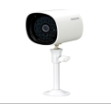
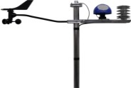




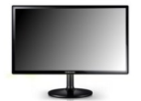

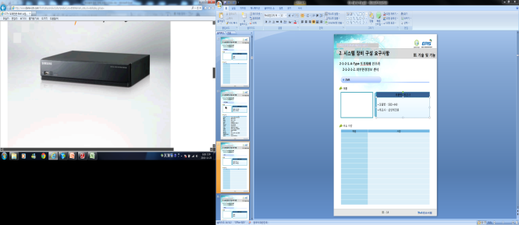









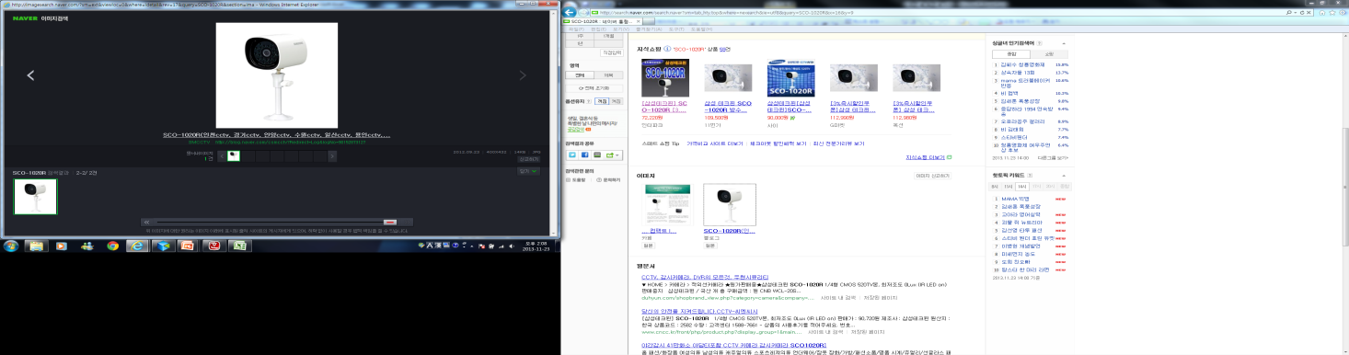
Hog Farm ICE System Diagram
Gestation Crate
Drinking Water
& Feed Bin
Temp/Humidity Sensor Node
Power Outage Sensor Node
Short circuit Sensor Node
IR Camera
External Weather
Station
Automatic Feed
Dispenser
Control Node
Drinking Water Level
Sensor Node
Feed Bin Inventory
Sensor Node
Vent Fan
Control Node
Maternity Barn
Temp/Humidity Sensor Node
Power Outage Sensor Node
Short circuit Sensor Node
IR Camera
External Camera
Automatic Feed
Dispenser
Control Node
DVR
Vent Fan
Control Node
INTERNET
Piglet Pen
Temp/Humidity Sensor Node
Power Outage Sensor Node
Power Outage Sensor Node
IR Camera
Hog Farm Integrated
ICT Control System
Hog Farm
Business
Management
System
Growing Pig Feed
Dispenser
Control Node
Vent Fan
Control Node
육
성
사
Video Info.
N Screen Device
EPIS
Information Sharing System
Temp/Humidity Sensor Node
Power Outage Sensor Node
Power Outage Sensor Node
Sorting Device
Control Node
IR Camera
Environ. Info.
Growing Pig Feed
Dispenser
Control Node
Control Info.
Vent Fan
Control Node

Slide 4
Dairy Farm ICT System Diagram
Winch Curtain
Milking Room
Playground
Feed Dispenser
Calf Nursing bottle
Fan cooler
Cooler
Individual Milk Meter
Milker
Drinking Water Container
Activity Measure-ment
Environmen-tal Data Collector
Quarantine Room
Storage Room
관리사
Sterilizer
Chiller
Management System

Slide 5
Broiler Farm ICT System Configuration
Broiler House
Automatic Feeder
Lighting Controller
Vent Fan
Chiller/ Heater Unit
Drink Amount Meter
Weighing Machine
Environment Data Collector
Quarantine Room
관리사
Sterilizer
Management System

Slide 6


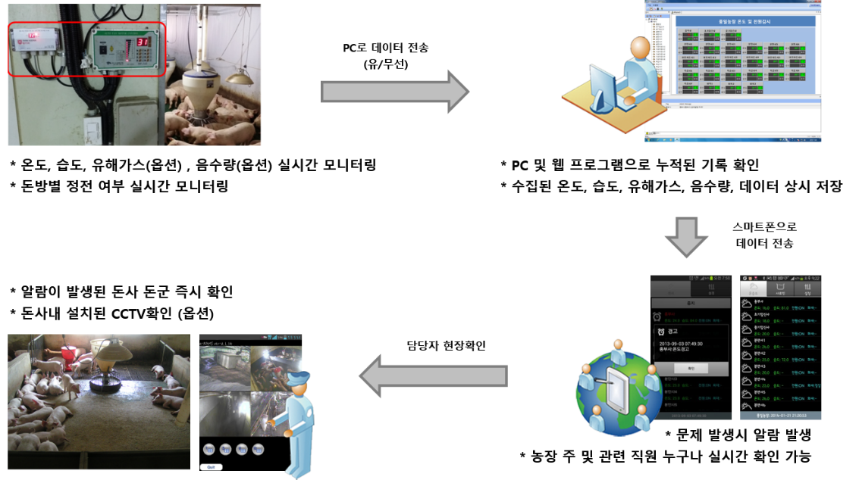
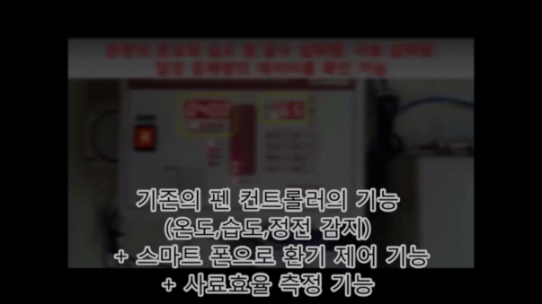
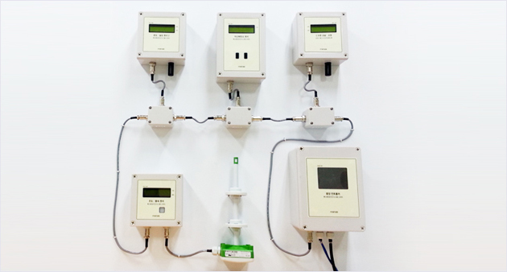
Environment Control Device
Environment Control System
Concept Map of Environ. Control system
Expected Effect
▷ Can monitor current temp., humidity, power outage, noxious gas inside pig pen
▷ Alarm generated for high and low temp., and power outage
▷ Reduce farm loss by preventing asphyxia
▷ Data-based consulting possible based on stored temp. data
▷Alarm check through PC program, Web program, or smart-phone
Environment Control System

Slide 7
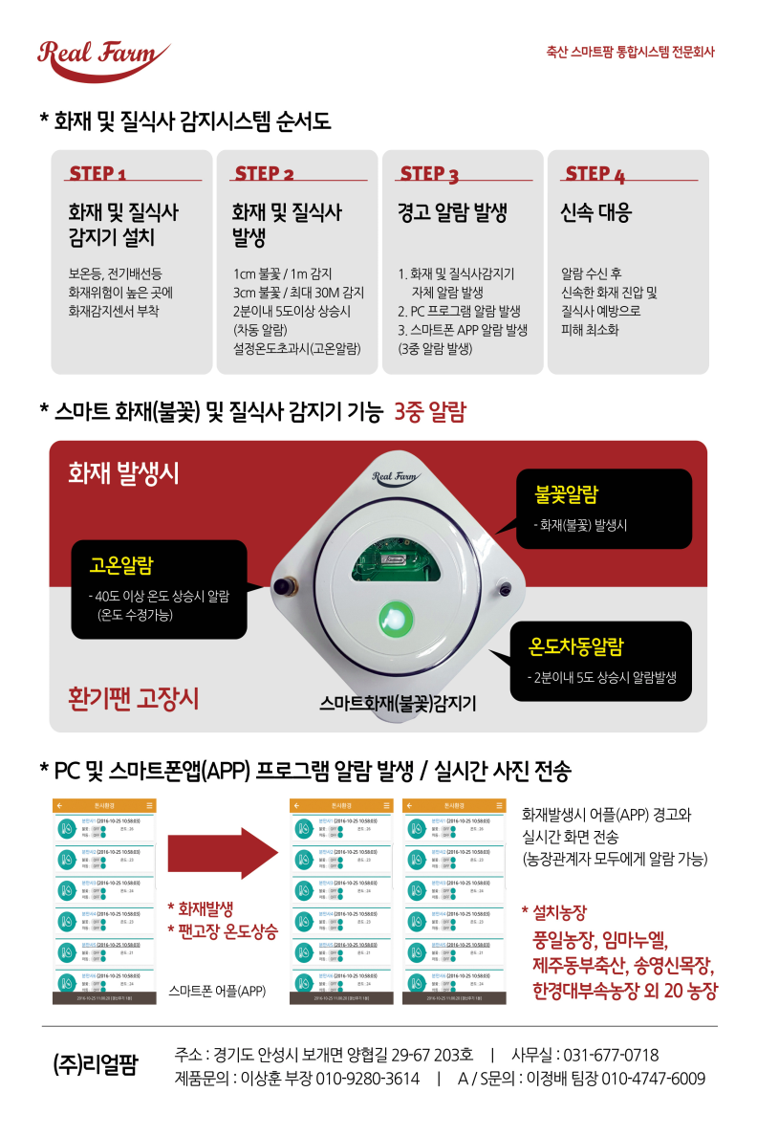

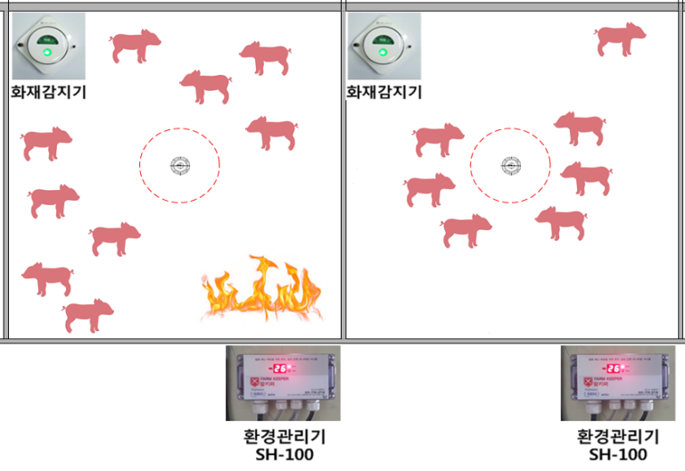

Fire and Asphyxia Detector
Fire Detector
Concept Map of Fire Detector
Rapid & Early
Suppression
of Fire
Via PC or Smart-phone
SendingFire Alarm
Expected Effect
▷ Can check current temp. inside pig pen
▷ Alarm generation for fire (flame), temp. difference (5°C increase within 2 min), or high temp. ( ≥40°C)
▷ Check fire alarm within 5 sec and early suppression of fire limiting damage
▷ Possible to check Alarm through PC / Web program, or smart-phone
▷ Possible to check real-time captured image in case of fire using CCTV

Slide 8
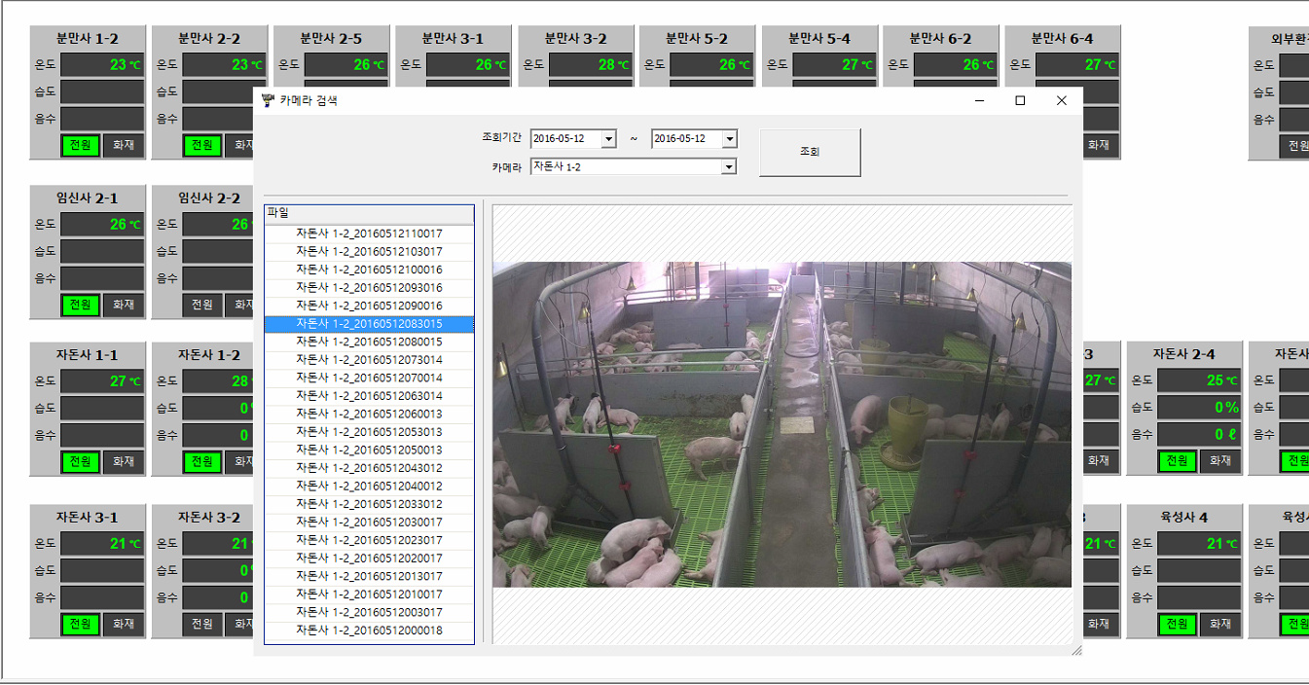

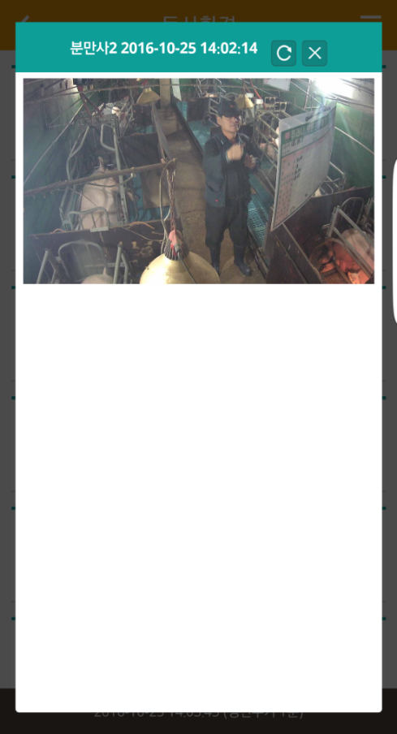
CCTV
Real-time check of environment and activity of pigs inside pig pen
Analyze pig activity, ventilation blind spot and behavioral pattern of pigs using auto-captured video image

Slide 9

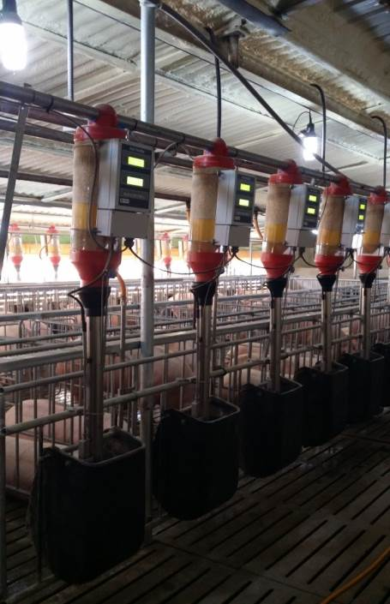

Sow Automatic Feeder
  Free from feeding chores for the sows
    Feed falls down automatically at the time set by the administrator
    Feed volume automatically changes according to feeding strategy
    Set the feeding time during cool hours in summer
    Help lactating sows feed as much as they want
  Saves feed cost
    Feed released only when sows hit sensor, minimizing loss of feed
    No feed released after feeding time or target intake is exceeded
    Drinking nipples can be installed outside the feed bin to reduce feed decay
  Only thing to do is to check sow who didn’t eat in the morning
    Check sows that didn’t eat the day before through the control computer or smart-phone
    Check the condition of automatic feeder by regularly checking the feed inventory meter
Benefits of Automatic Feeder

Slide 10

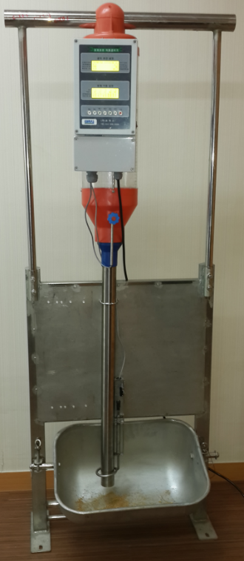
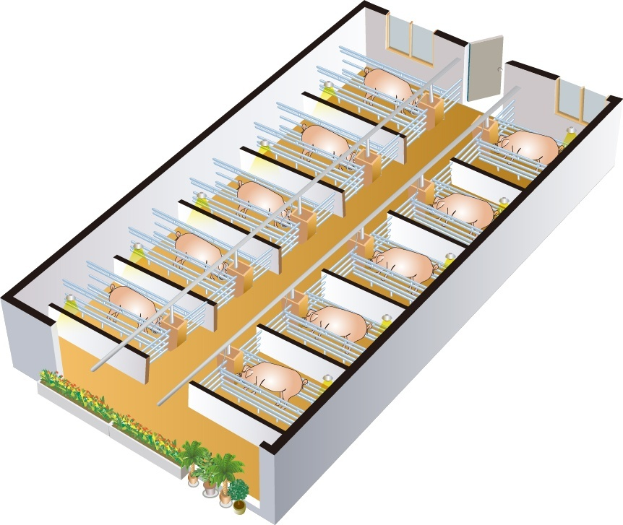


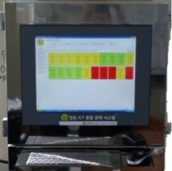

Sow Automatic Feeder Network Diagram
Repeater
Gateway
INTERNET
Hog Farm Integrated ICT Control System
Pig Production and Management System
(Pig Plan)
EPIS
Data Sharing System

Slide 11
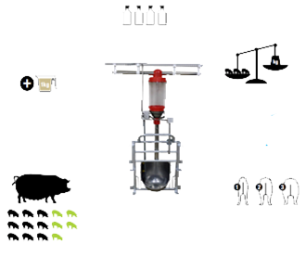


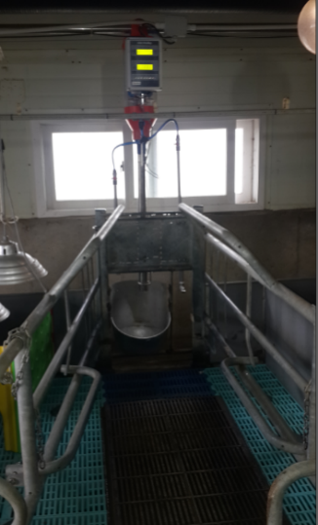


Increasing weaning piglets and reducing non-production days by feeding individual animals considering the sow’s piglet number, BCS and lactating piglets
Benefits of Automatic Feeder for Lactating Pig
Effect of Automatic Feeder for Lactating Pig
모돈의 젖 생산량 증가
  Weaning Weight for Sow - 0.3kg increased
  ₩ 25,525/sow/year
Maximize Sows’ Feed Intake
  Weaning-Mating Interval reduced by 1.8 days
  ₩ 8678/sow/year
Lactating Period
Weaning Piglet Weight Gain
  Feed intake during pregnancy reduced by 0.25g
  ₩ 24,504/sow/year
  Delivery rate increased by 8%
  ₩ 16,336/sow/year
Healthy BCS for Sows
  PSY increased by 1.5
  ₩ 61,260/sow/year
Increase in Litter Size Next Tiime
  Sow longevity increased
  ₩ 30,630/sow/year
Reducing Weaning-Mating Interval and Increasing Fertility Rate
Reduced labor cost
  ₩ 18,378/sow/year
Potential effect: ₩ 185.311/sow/year
Notes:
Incre

Slide 12

Military Feeder for Gestating Sow
Principles of Military Feeder for Gestating Sow
  RFID tag per individual sow
  When sow enters the feeder, controller recognizes the sow and feeds according to
  the gestational age
  Sows that have consumed their daily intake are no longer fed to maintain
  their body shape
  Check for accident sow (miscarried sow) that have lost RFID tag or consumed
  less on the day before by checking the computer system
Benefits of Military Automatic Feeder for Gestating Sow
Drawbacks of Military Automatic Feeder for Gestating Sow
  Increased exercise, sow robustness &
  increased longevity
  Reduction of difficulty in deliver (shorter delivery
  time, reduced stillbirth, postpartum congestion)
  Reduction of difficulty in delivery → Maintaining
  Stable lactating activity
  → Induction of normal estrus after weaning
  The process of increasing animal welfare
  운동량 증가만큼 사고(투쟁, 지제사고)의 위험도 증가 Increased risk of accidents (fighting, ) due to increased exercise
  RFID tag drop-out rate : 5% → Need to issue again
  Be sure to install spare feed bowl in cased of equipment failure
  Some sows need to be trained to adopt
  (use of partition)
  Some sows never adopt
  (reserve sow 5%, group-housed sow 15~30%)

Slide 13
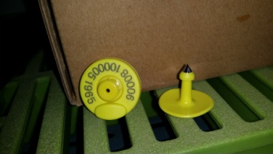
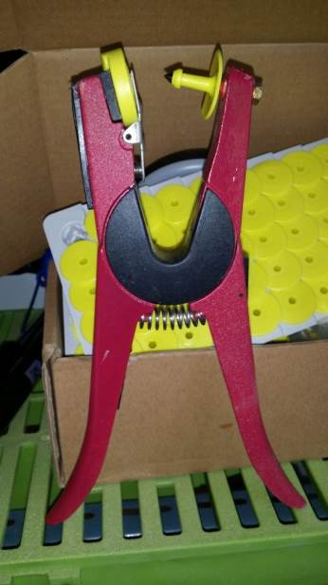
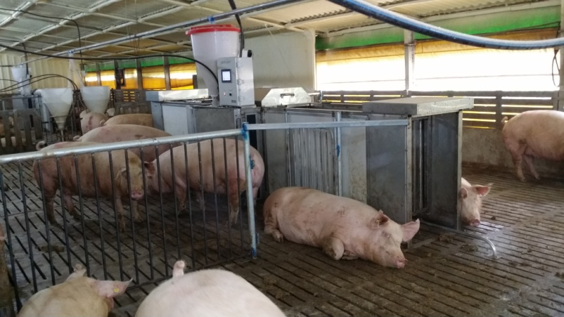
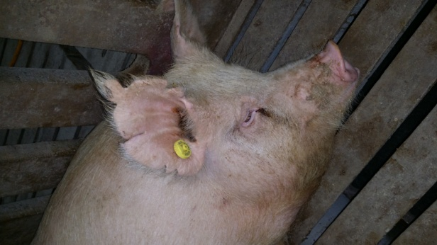
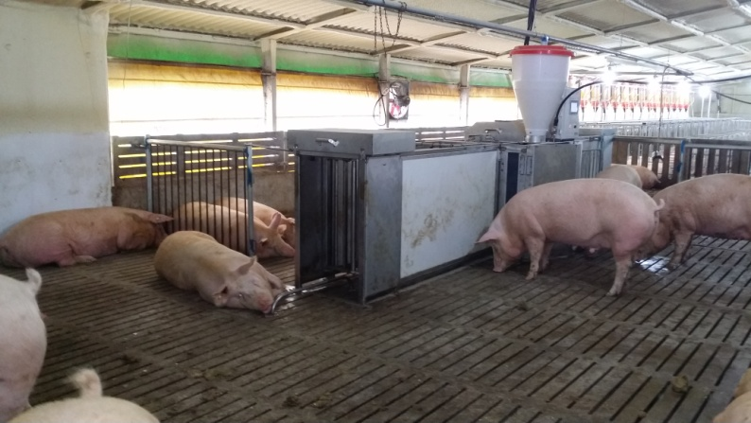
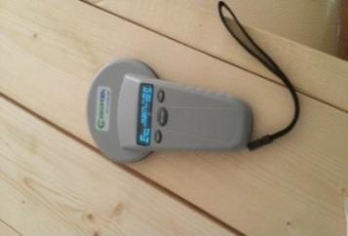
▼ RFID Tag
▼ Tag Installer
◀ Handheld Type RFID Reader

Slide 14







Principles of Military Feeder Operation for Gestating Sow
1
Sow enters through the entrance door
2
Entrance door closed when a sow entered
3
Recognize the sow through RFID reader
Feed sow according to set feeding amount
4
5
Sow exits when feeding is complete

Slide 15
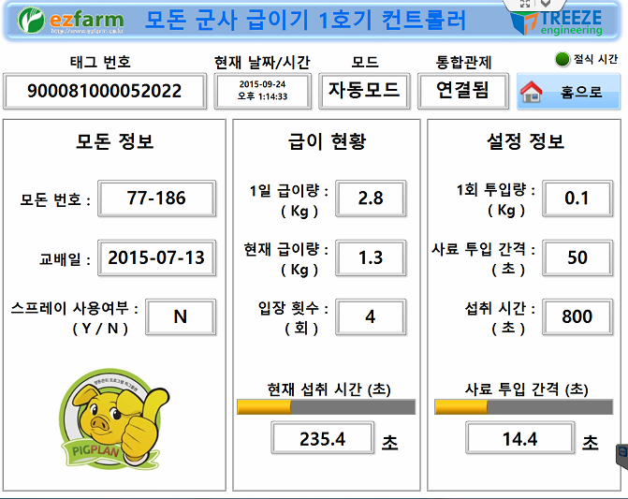
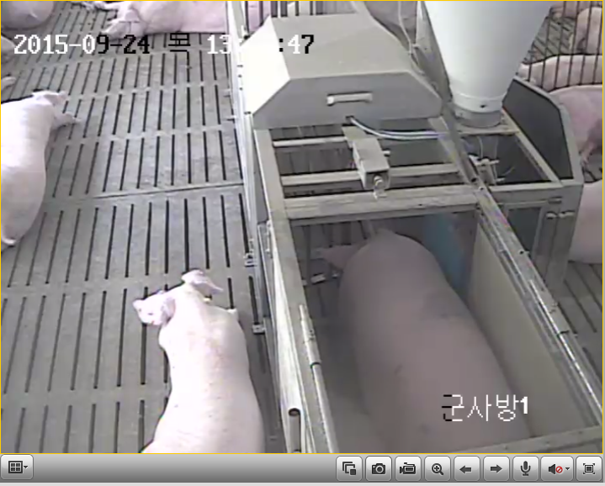
Spray Function
More than 2
groups of sows
are mixed
Mark sows who
need to be
transferred for
vaccination or
expected delivery

Slide 16
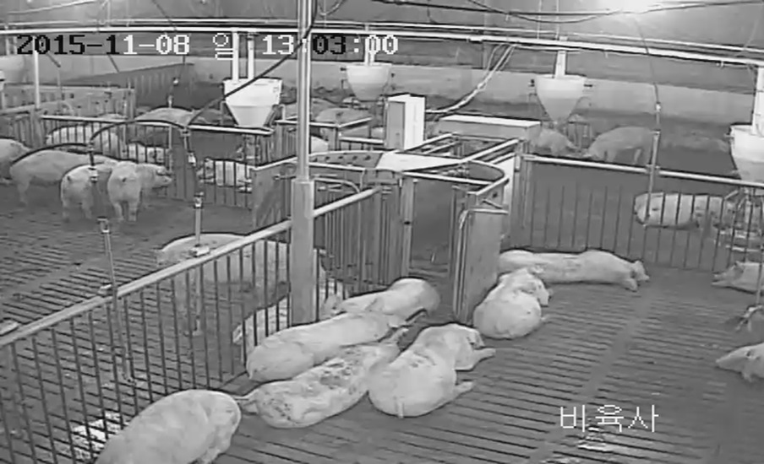
Pig Sorting Device (Sorter)
Purpose (Effect)
Principles of Sorter
  Release standard pigs
  (pigs over certain weight, to reduce error
  of sorting with naked eyes)
  Fasting is possible before shipping
  (Only water intake in shipping compartment)
  Easier pig sorting
  Less overweight pigs
  Separation of feed (dry) and drinking water compartment
  Pigs need to move to drink water
  When pig enters the sorting device, weight is measured
  - Depending on the weight, the exit is different
  - Pigs meeting the shipping weight are transferred to
  shipping compartment and locked up
  - Underweight pigs move to the opposite compartment
  to drink water and can go back to the feeder compartment
  More than 80% of pigs are selected after 12 hours of
  operation the day before shipment
  Big pigs who do not pass the sorting device must be herd separately

Slide 17
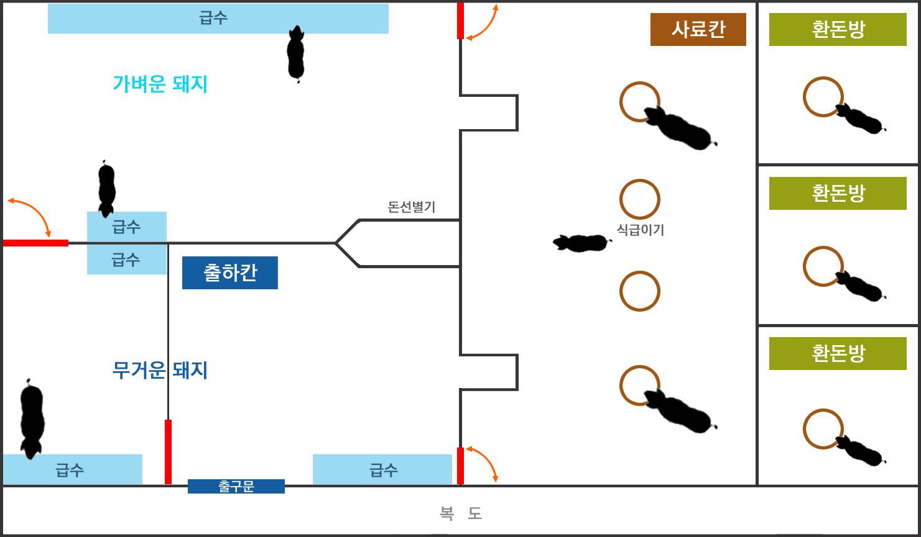
14m
16m

Slide 18
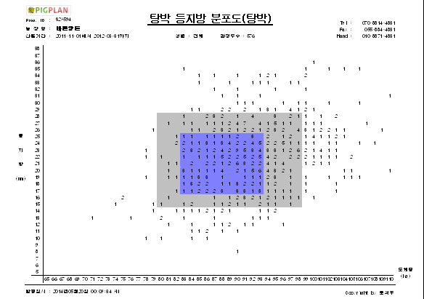
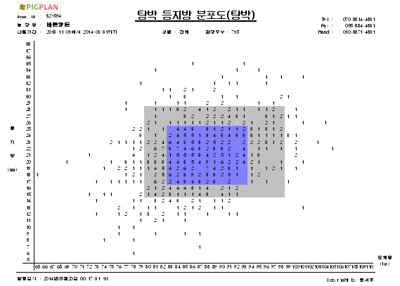
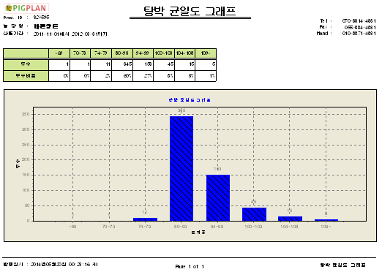
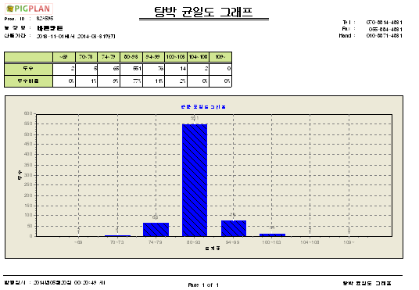
With the pig sorter, maximize farm income by raising shipping grade, saving labor, and fasting before shipping
Use Case of Pig Sorter
Effects of Automatic Sorting
  “ㅂ Farm” Application
  Selective shipment of standard pigs raises shipping grade
  Shortening of shipping time and shipping of uniform pigs through automatic sorter
  Reduction of labor by automatic sorting through sorter
  Less stress of pigs when being transported after fasting
  Improved meat quality due to reduced stress during transportation
[Before: 1,1+Grade Appearance Rate : 62%~76%]
[Before : 1,1+Grade Appearance Rate : 85%~]
  Higher meat processing yield and productivity

Slide 19
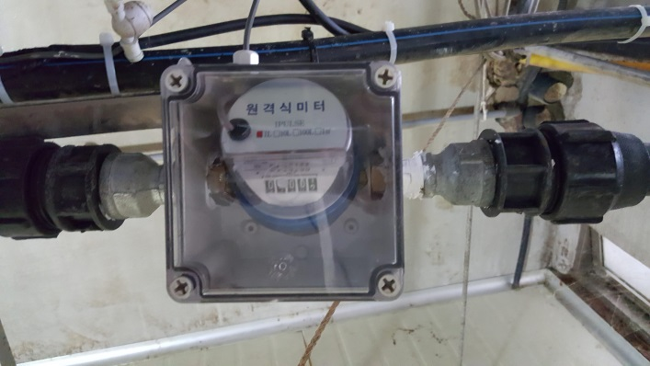
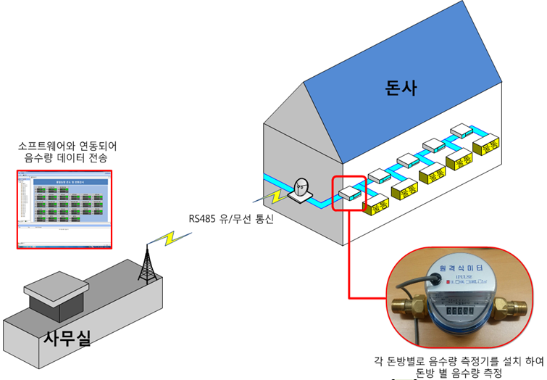
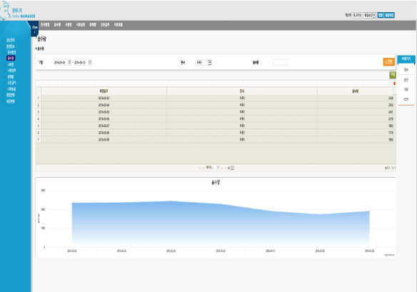
Water Intake Management System
Prevent farm damage using water intake management system
Detection of water leak and saving, and alert sound delivered to smart-hone
Water Intake Meter
Concept Map of Water Intake Meter
Water Intake Measuring Sensor
Expected Effect of Water Intake Meter
▷ Compare water intake volume to the previous day to identify problems with pig pen and improve breeding environment
- Prevent safety accident such as rupture of drinking water line
▷ Reduced pig mortality through early prediction of disease by pen
▷ Reduction of manure treatment cost due to damage of drinking water line
Water Intake Data

Slide 20
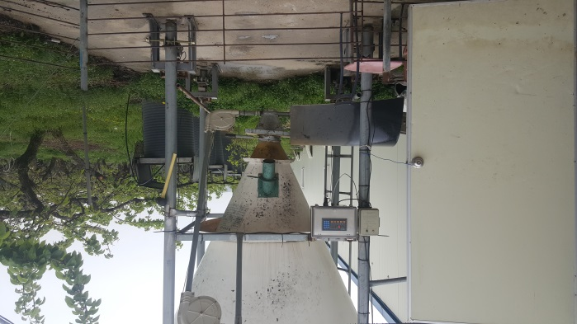





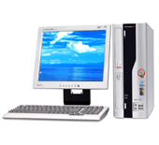


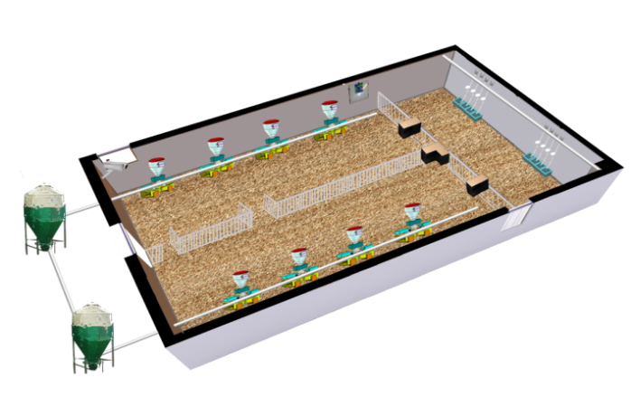


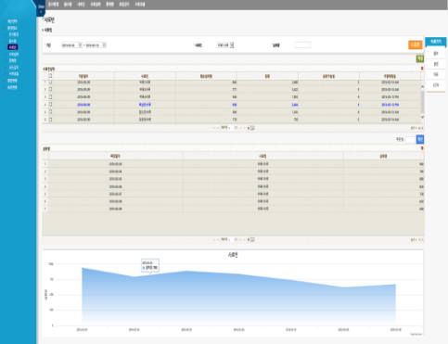
Feed Bin Manager
Feed Bin Manager
Concept Map of Feed Bin Manager
Feed Order
Feed Management
Internet
Farm
Administrator
Feed Firm
Alert when problem occurs
Farm Server
Feed Bin Manger
Gateway
Feed Controller
Expected Effect
▷ Checking of feed bin inventory and analysis of feed consumption patter by feed bin
▷ Identify feed supply condition by checking feed intake 2 days or 1 day before
▷ Save feed cost through analysis of feed receipt date and stock volume
▷ Fresh feed is always available through planned orders
Feed Bin Data

Slide 21
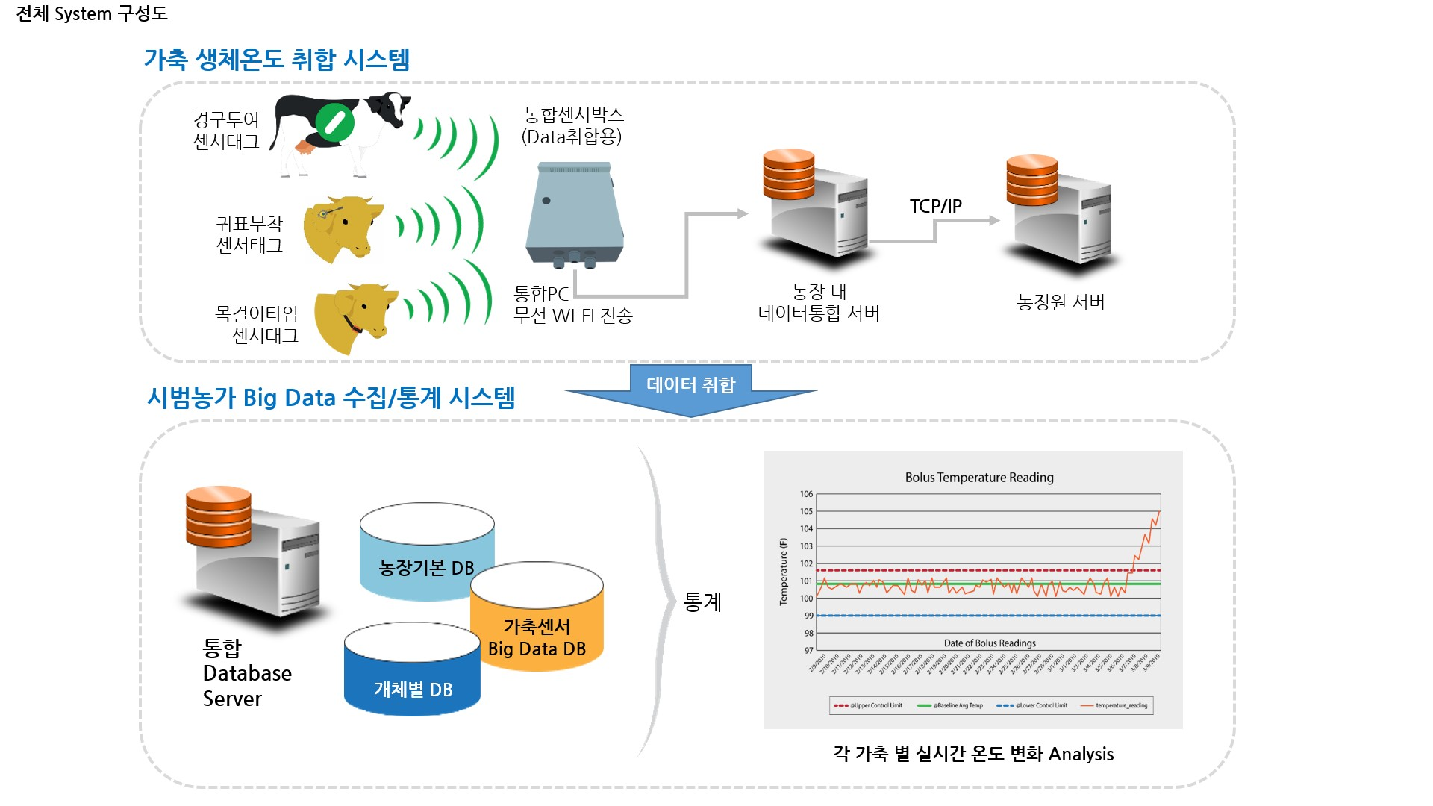
Cattle Breeding Management System

Slide 22
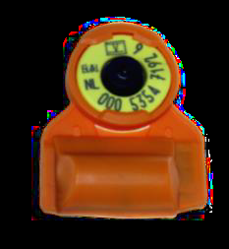
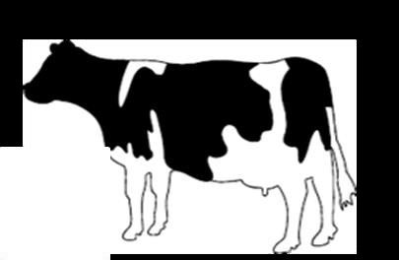
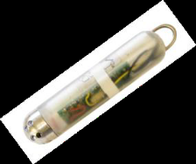
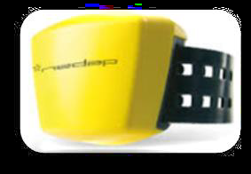
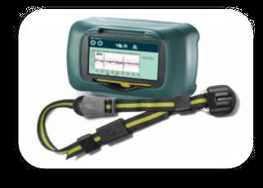
Ear marker type: estrous (active), rumination, feed intake, disease discovery, Feedfactor
Ankle bracelet type: estrous (active)
Necklace type: estrous (active), rumination

Slide 23
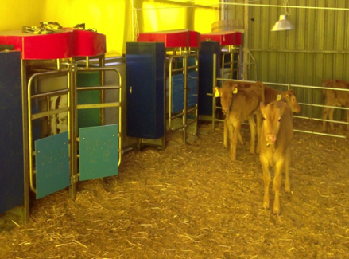
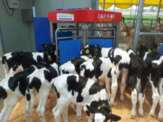
Robot Calf Nursing Device
- Management of automatic milk replacer feeding for individual calf
- Monitoring and controlling of daily intake for each calf

Slide 24
Seasonal melting point / temperature of milk replacer should be considered.
It helps managing the health of calves as individual intake of milk replacer is identified.

Slide 25
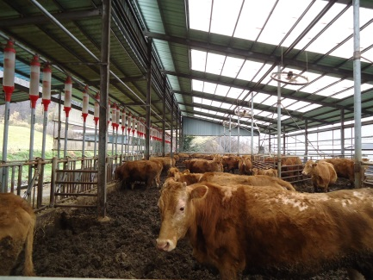
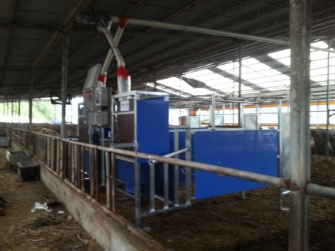
Cattle Weight Scale
Feeding amount can be adjusted depending on body weight and breeding stage
Proactive management of health and performance by changing weight and feeding volume

Slide 26
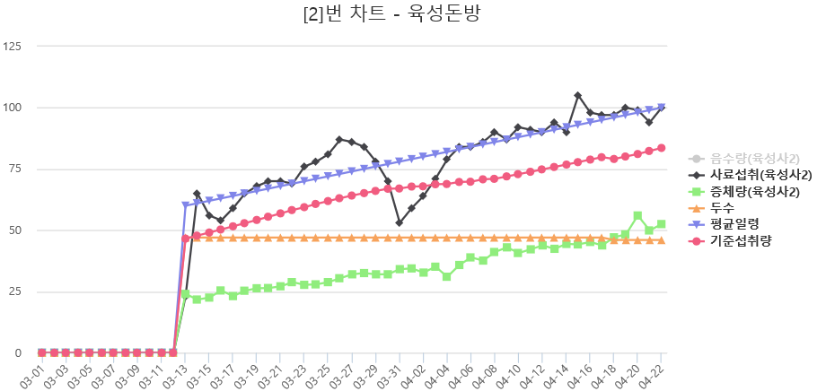




Data Analysis
Active Pigs
웅크린 돼지들
26

Slide 27



Slide 28


Slide 29





Slide 30





Slide 31
Thank You

